Slide 1
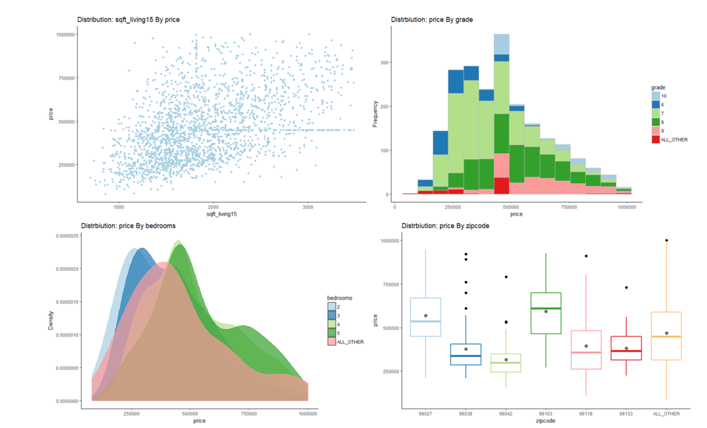
Lesson 25: Exploratory Data Analysis
SE370 – Computer-Aided Systems Engineering
MAJ Jae Kim DSE- Instructor

Slide 2
Today
Lesson 25: Data Visualization II
  1. Visualize and summarize data to understand variation, typical values, and unusual values
  2. Visualize and summarize data to understand co-variation between variables
  3. Generate hypothesis about data using visualization, transformation, and modeling"
2

Slide 3
Next Lesson
Lesson 26: WPR Review
  WPR – In class on Lesson 27 (01APR2022)
3

